Slide 1
Version Control GitHub
Unit 7

Slide 2
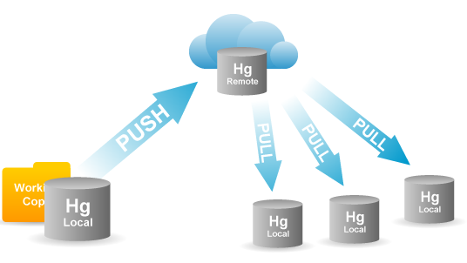
Version Control System
helps people to review and edit code together

Slide 3
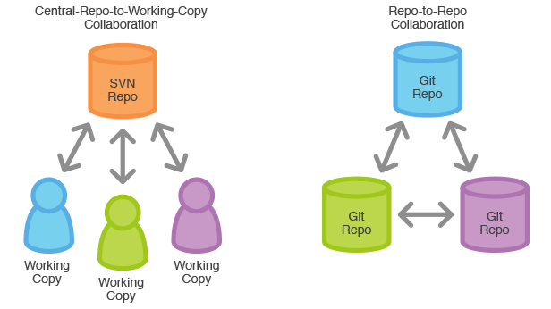
Github vs SVN
https://www.atlassian.com/git/

Slide 4
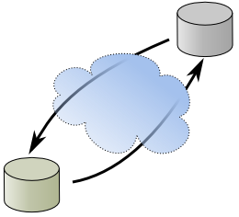
Github VCS
GitHub repository
local Git repository

Slide 5
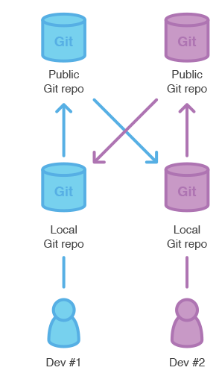
Github - Commit-Push-Pull
Commit - records changes to the local repo
Push - updates objects in the remote repo
Pull -
Fetches changes from a remote repo
Merges changes into the local repo
pull
push
push
commit
commit

Slide 6

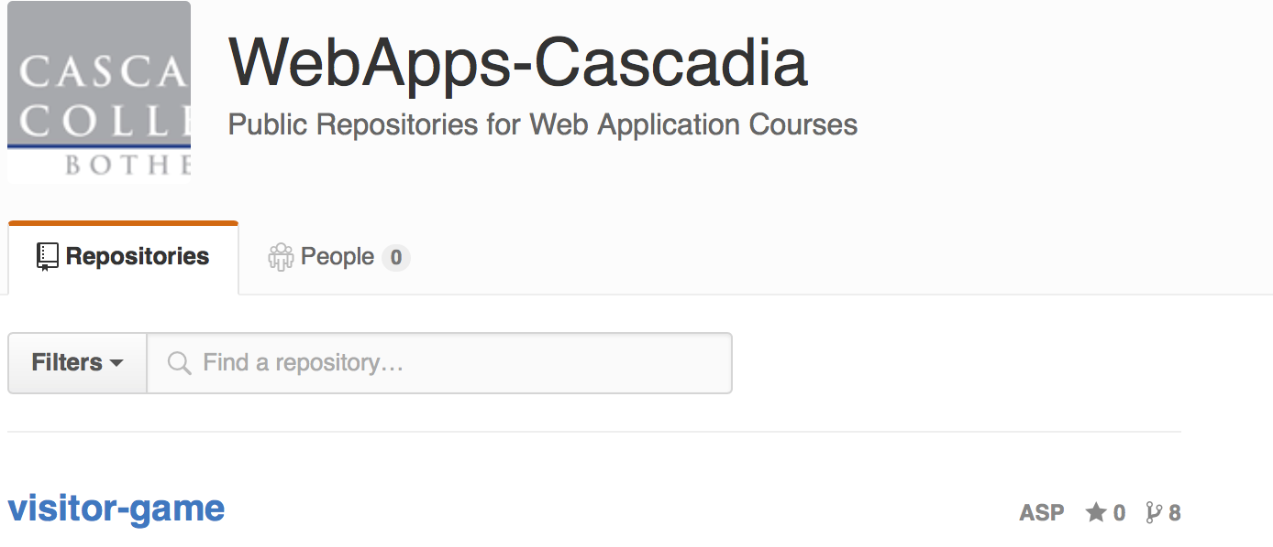
https://github.com/WebApps-Cascadia
github home page for the class
you may need to download git.exe from
http://git-scm.com/download/win or http://msysgit.github.io

Slide 7

Visual Studio & Github
Team Explorer -> -> Clone
type in Repo site https://github.com/WebApps-Cascadia/debug-demo.git
type in a local drive
Make your changes to the code
Changes -> (enter a commit msg) -> Commit (commit created locally)
Sync (you will get an 403 Forbidden error)

Slide 8
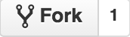

Submitting with Github
Fork the repository to your account from https://github.com/WebApps-Cascadia
Edit your code in Visual Studio with Version Control (VCS) - same a before
Sync to your Github repository
To submit, create a pull request from your updated repository

Slide 9
Team Development with Github
Unit 11

Slide 10

Gitflow Workflow
http://nvie.com/posts/a-successful-git-branching-model/

Slide 11
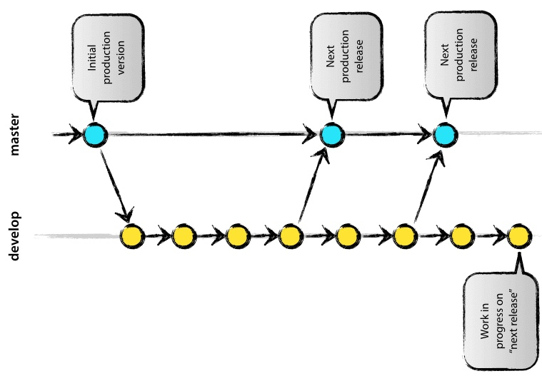
Gitflow: develop branch
http://nvie.com/posts/a-successful-git-branching-model/

Slide 12
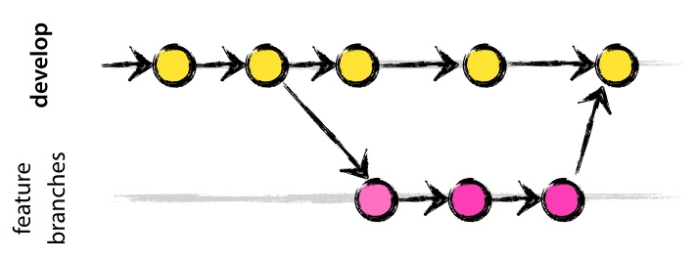
Gitflow: feature branch
http://nvie.com/posts/a-successful-git-branching-model/

Slide 13
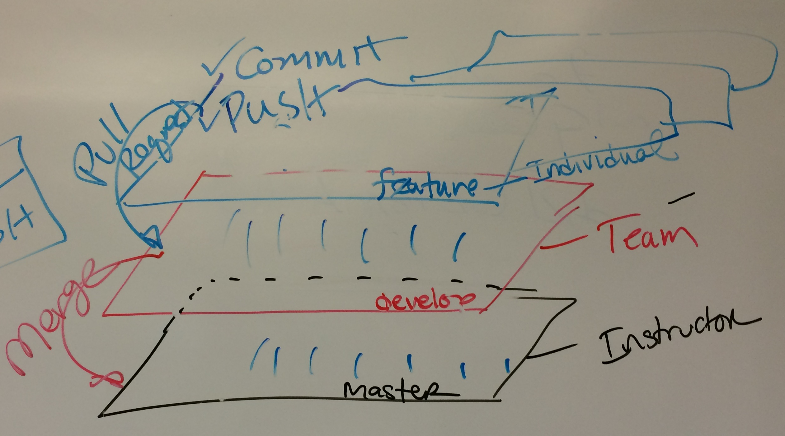
Team Development
https://www.atlassian.com/git/tutorials/comparing-workflows/gitflow-workflow

